Slide 1
Secure Data Hiding in Image Using Steganography
Encrypt and hide data with steganography to prevent cyberattacks
Presented By: PREMSAGAR J
Student Name: PREMSAGAR J
College Name & Department : DAYANAND SAGAR ACADEMY OF TECHNOLOGY AND MANAGEMENT

Slide 2
OUTLINE
Problem Statement
Technology used
Wow factor
End users
Result
Conclusion
Git-hub Link
Future scope

Slide 3
Problem Statement
This project aims to securely embed sensitive data within image files using steganography, making sure the hidden information stays undetectable and the image quality remains intact. The main challenge is to prevent unauthorized access to the concealed data while optimizing the amount of data hidden and preserving the integrity of the image.

Slide 4
Technology used
OpenCV for Image Processing: Uses the OpenCV library to read, modify, and save images. The image's pixel values are altered to hide the secret message.
Data Encoding: Converts the secret message into ASCII values and embeds them into the image's pixel colors (RGB values).
Decryption: A passcode is required to extract the hidden message. If correct, the program reads the pixel values and reconstructs the original message.
Passcode Security: Protects the hidden message by requiring a passcode for decryption. Without the correct passcode, the message cannot be accessed.

Slide 5
Wow factors
This project lie in its ability to hide sensitive data inside an image without altering its visual appearance, making the information nearly undetectable. It adds an extra layer of security by requiring a passcode for decryption, ensuring only authorized users can access the hidden message. The project doesn’t rely on complex encryption algorithms, yet it effectively secures the data through a clever use of pixel manipulation. The image’s integrity is preserved, allowing the hidden message to remain invisible. This method is adaptable for various real-world applications, including secure messaging and digital watermarking.

Slide 6
End users
Government agencies could use this project to securely store or transmit classified information by embedding it in images, making it harder for unauthorized individuals to access or detect the hidden data. This could be valuable for communicating sensitive documents, intelligence reports, or confidential messages without the risk of interception during transmission. The added passcode protection ensures that only authorized personnel can decrypt the hidden data. Additionally, it can be used for secure verification, such as embedding digital signatures or watermarks into official documents or images to prove authenticity

Slide 7
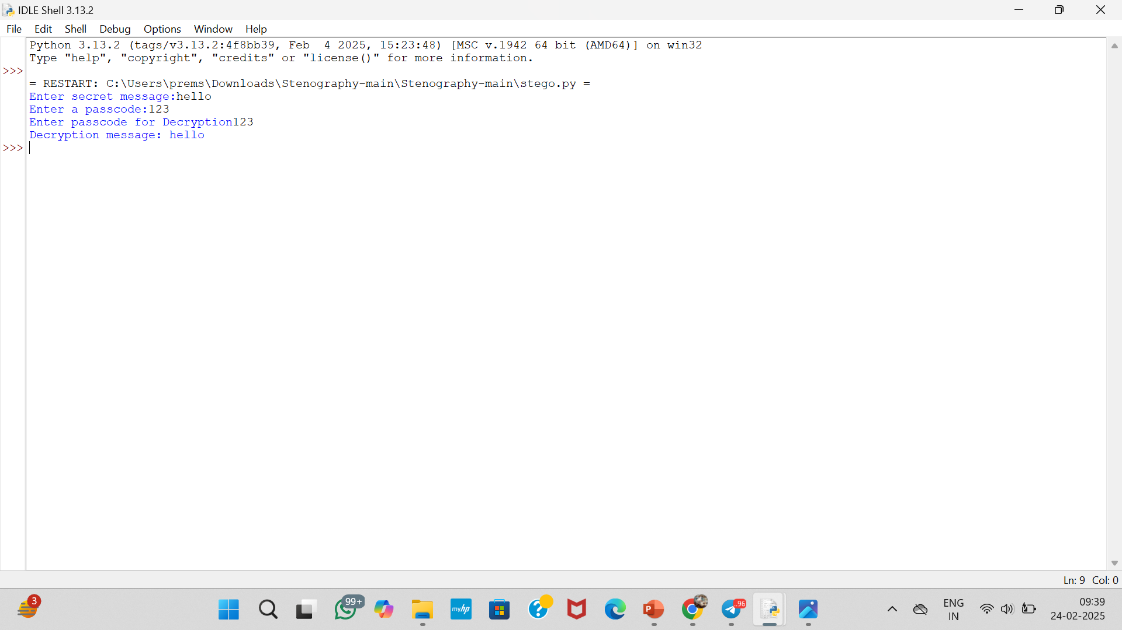
Results : OUTPUT
Screenshots of the outcome (min 3)

Slide 8

ENCYRPTION PICTURE

Slide 9

DECRYPTED PICTURE

Slide 10
GitHub Link
https://github.com/unkown0111/Project1.git

Slide 11
Conclusion
In conclusion, this project effectively hides sensitive data within images using steganography, ensuring the information remains concealed and the image quality is unaffected. It addresses the challenge of securing the hidden data from unauthorized access while maximizing the capacity for embedding information. By balancing data security and image integrity, the project provides a practical solution for secure communication and data storage. This method can be applied in various fields, offering a simple yet powerful approach to protecting sensitive information.

Slide 12
Future scope(optional)
In the future, AI tools could be integrated into this project to enhance data hiding and extraction techniques. AI algorithms, such as machine learning models, could be used to detect optimal locations within an image for embedding data without compromising its quality. AI could also assist in automating the detection and prevention of steganography attacks, making hidden messages more secure. Additionally, AI-driven image recognition could help improve the robustness of the technique, allowing it to resist detection by advanced forensic tools.

Slide 13
THANK YOU

